Slide 1



CLAMIFY - LOST & FOUND
HOME
ABOUT
MORE
Lost & Found
Application
Next Slide for More

Slide 2



CLAMIFY - LOST & FOUND
HOME
ABOUT
MORE
Our Team
Praveena Venkat Raj
Krishna Das
Siddhi Damkondwar
Dhanasri Krishnamurthy
Guided By:
Suramya Biswas

Slide 3

CLAMIFY - LOST & FOUND
HOME
ABOUT
MORE
Problem Statement - Lost Items on Campus
01
02
03
No Centralized Statement
Manual Search Inefficiency
Communication Breakdown
Campus loses 1000+ items annually with no centralized system for tracking or retrieval management.
Manual processes cause delays; owners spend hours searching without systematic photo or location matching.
Communication gaps between finders and owners result in lost items remaining unclaimed permanently.

Slide 4



CLAMIFY - LOST & FOUND
HOME
ABOUT
MORE
Our Solution : Clamify - Lost & Found Application
We developed an intuitive web application designed to streamline the process of locating lost and found items within the campus community.
User-Friendly Platform
Quick Matching & Recovery
Community Bridge
A simple, accessible interface allows anyone to report or search for items with ease.
Facilitates rapid connections between finders and owners, significantly improving recovery rates.
Actively bridges the communication gap between individuals and campus authorities.

Slide 5






CLAMIFY - LOST & FOUND
HOME
ABOUT
MORE
Technical Architecture
Frontend Backend Database Security & Tools IDE
HTML, CSS, Js
React Js, Figma
Java (Spring Boot)
RESTful APIs
MySQL 8.0
Spring Security
Git & Github
Postman
Eclipse
Vs Code

Slide 6



CLAMIFY - LOST & FOUND
HOME
ABOUT
MORE
Key
Features
User - features
Additional User Features
Users can easily post detailed information about lost or found items, including rich descriptions.
A powerful search functionality allows users to filter items by category or relevant keywords for quick identification.
An intuitive admin panel provides campus authorities with the tools to efficiently manage item claims and verify ownership before item release.
Fuzzy logic used to search items- makes it more responsive and close to real world

Slide 7

CLAMIFY - LOST & FOUND
HOME
ABOUT
MORE
Modules Overview
AUTHENTICATION & ROLE MANAGEMENT
LOST & FOUND ITEM POSTING
Secure login and registration
Role-based access: Student and Admin
Campus email verification
Users can post lost or found items
Includes description, date and location.
AUTO-MATCHING & SEARCH
CHAT / CONTACT SYSTEM
Automatically suggests matching lost/found items
Keyword and fuzzy matching used
Fuzzy logic helps my lost and found application match similar items even when the details are not exactly the same.
Secure in-app communication between users
Privacy maintained unless details are shared
ADMIN DASHBOARD
Content moderation
Reporting and analytics

Slide 8
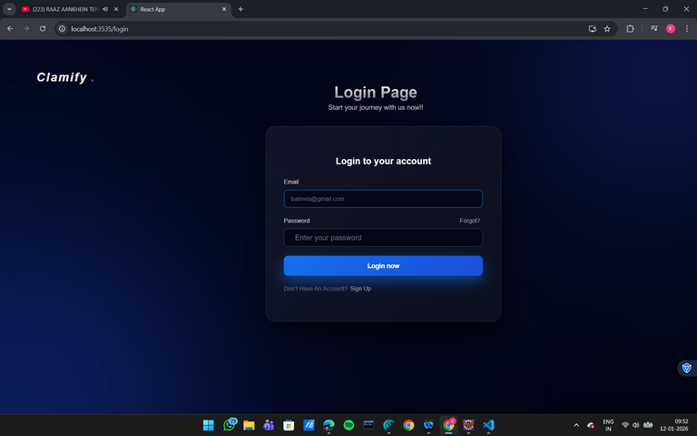
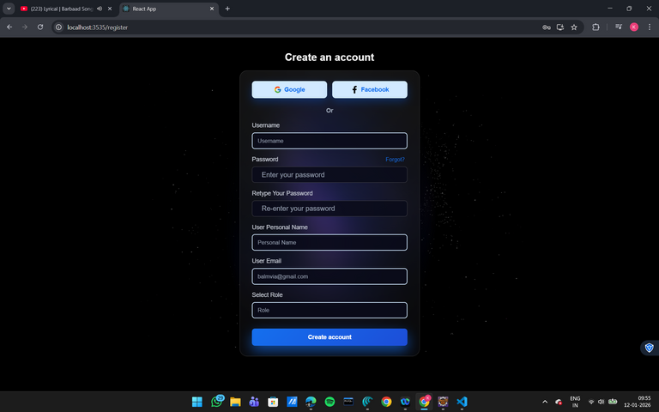
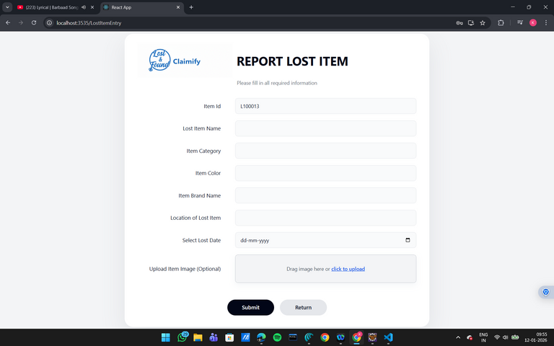
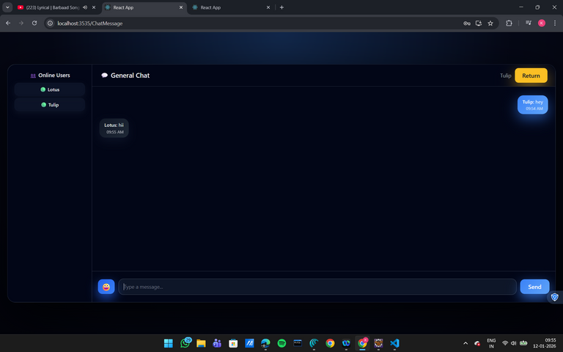
CLAMIFY - LOST & FOUND
HOME
ABOUT
MORE
LOGIN PAGE
SIGNUP PAGE
LOST ITEMS FORM
CHATTING

Slide 9


CLAMIFY - LOST & FOUND
HOME
ABOUT
MORE
Future Enhancement
Mobile application support
AI-based image recognition for better matching
Push notifications for match alerts
Multi-campus scalability

Slide 10



CLAMIFY - LOST & FOUND
HOME
ABOUT
MORE
Challenges & Conclusion
Conclusion
Built a secure, scalable campus lost and found system applying full-stack development concepts.​
Digitized manual processes with a centralized platform to improve efficiency and item recovery.​
Gained hands-on experience in backend development, REST APIs, authentication, security, and teamwork.
API Integration Issues
CORS Configuration
Maintenance
Initially faced 404 errors and endpoint mismatches during the API integration phase.
Encountered challenges ensuring CORS was correctly configured for frontend-backend communication.
Maintaining clean data and logs for audit is hard at scale.

Slide 11

CLAMIFY - LOST & FOUND
HOME
ABOUT
MORE
Thank
Contact Us:
You!
support@claimify.app
github.com/lostfoundApplication

